Slide 1
Philosophy of Engineering
Unit - 5
Axiology of Engineering
Engineering and Society- Engineers Code of Ethics - Sustainability and Diversity - Engineer’s role to achieve Sustainable Development - Socio-Politics of Technology & Engineering - Professional Engineering Organizations
Practice 13: Evaluate Popular Inventions and apply their new point of view to Re-Design
Practice 14: Case Study on Achieving Sustainable Development Goals
Practice 15: Case Study on Professional Engineering Organizations
Prepared by
Dr. M . Vikneswaran
Assistant Professor, Mechanical Engineering, SRMIST, Ramapuram

Slide 2
Axiology of Engineering
Theory of Value
The two major subdivisions of axiology are
Aesthetic value and
Ethical value
Study of values of things
What principles should one live by?
What are the desirable values?
Is morality defined by what we speak or feel?
What is the blueprint of family values?
What is true beauty?
What is immoral and moral?

Slide 3
ENGINEERING AND SOCIETY
Engineering plays a profound and ubiquitous role in shaping the modern world and influencing society in countless ways.
From the towering skyscrapers that define our cities to the intricate microchips that power our devices, engineering solutions have revolutionized industries, transformed our daily lives, and propelled humanity forward.
Impact of Engineering on Infrastructure and Development
Engineering has been instrumental in building the infrastructure that underpins our civilization.
From transportation networks that connect communities to energy systems that fuel our economies, engineers have designed and constructed the essential frameworks that support modern society.
Bridges, roads, railways, tunnels, airports, and power grids – all these marvels of engineering have enabled the movement of people, goods, and information, fostering economic growth and facilitating global connectivity.

Slide 4
Engineering for Sustainability and Environmental Protection
As we face the pressing challenges of climate change and environmental degradation, engineering solutions are becoming increasingly crucial.
Engineers are developing innovative technologies to harness renewable energy sources, reduce pollution, and promote sustainable practices.
From solar panels and wind turbines to smart buildings and energy-efficient appliances, engineering advancements are helping us transition to a greener future.
Engineering in Healthcare and Medical Technology
Engineering has revolutionized the field of medicine, leading to breakthroughs that have improved human health and extended lifespans.
From life-saving medical devices to advanced diagnostic tools, engineering innovations have transformed healthcare delivery and patient outcomes.
Artificial limbs, prosthetics, and implantable devices have restored mobility and independence, while minimally invasive surgical techniques have reduced recovery times and improved patient well-being.

Slide 5
Engineering for Communication and Information Technology
The digital age is a testament to the transformative power of engineering.
Engineers have pioneered the technologies that underpin our interconnected world, from the invention of the telegraph and telephone to the development of the internet and mobile computing.
These advancements have revolutionized communication, enabled real-time global collaboration, and fostered unprecedented access to information.
Ethical Considerations and Societal Impact
While engineering has undoubtedly brought about immense progress, it is also important to consider the ethical implications and societal impact of technological advancements.
Engineers must be mindful of the potential unintended consequences of their work, ensuring that technological innovations are developed and deployed in a responsible and ethical manner.
Social equity, environmental sustainability, and data privacy are just a few of the critical issues that engineers must address as they shape the future of technology.

Slide 6
ENGINEERS CODE OF ETHICS
Engineering is an important and learned profession.
As members of this profession, engineers are expected to exhibit the highest standards of honesty and integrity.
Engineering has a direct and vital impact on the quality of life for all people.
Accordingly, the services engineers provide require honesty, impartiality, fairness, and equity, and must be dedicated to protecting public health, safety, and welfare.
Engineers must perform under a standard of professional behavior that requires adherence to the highest principles of ethical conduct.

Slide 7
Fundamental Canons
Engineers, in the fulfillment of their professional duties, shall:
Hold paramount the safety, health, and welfare of the public.
Perform services only in areas of their competence.
Issue public statements only in an objective and truthful manner.
Act for each employer or client as faithful agents or trustees.
Avoid deceptive acts.
Conduct themselves honorably, responsibly, ethically, and lawfully so as to enhance the honor, reputation, and usefulness of the profession.

Slide 8
Things to consider under each fundamental canons
Engineers must tell their employer, client, and other authorities if their judgment is overruled in life-threatening situations.
Engineers should only accept standard-compliant engineering documents.
Engineers may not disclose facts, data, or information without client or employer authorization unless authorized or required by law or this Code.
Engineers must not allow the use of their name or do business with fraudulent or dishonest companies.
An engineer cannot assist a person or firm in illegal engineering.
Engineers who know of any alleged Code infringement must notify competent professional bodies and, when needed, public authorities and cooperate with them in providing any necessary information or support.
Engineers shall hold paramount the safety, health, and welfare of the public.

Slide 9
Things to consider under each fundamental canons
Engineers cannot sign designs or documents they are unfamiliar with or that were not developed under their guidance and control.
Engineers can accept assignments, coordinate a complete project, and sign and seal engineering documents for the entire project if each technical segment is signed and sealed by the qualified engineers who created it.
Engineers shall perform services only in the areas of their competence.
Engineers can publicly voice technical opinions based on facts and expertise.
Engineers shall not issue statements, criticisms, or arguments on technical matters inspired or paid for by interested parties unless they shall first identify the interested parties on whose behalf they are speaking and disclose any interest they may have in the matters.
Engineers shall issue public statements only in an objective and truthful manner.

Slide 10
Things to consider under each fundamental canons
Engineers may not accept money or other compensation from several parties for the same project unless all parties are informed and agree.
Engineers may not solicit or accept cash or other valuable consideration from outside intermediaries for their work.
Engineers serving in public service as members, advisors, or employees of governmental or quasi-governmental bodies or departments cannot vote on services sought or supplied by them or their organizations in private or public engineering practice.
Engineers may not solicit or accept contracts from public bodies on which their principals or officers serve.
Engineers shall act for each employer or client as faithful agents or trustees.
Engineers must disclose all known or possible conflicts of interest that could affect their judgment or service quality.

Slide 11
Things to consider under each fundamental canons
Engineers must not lie about their or their associates' qualifications.
They may not inflate their responsibility for earlier assignments.
Employers, workers, colleagues, joint venturers, and past accomplishments may not be misrepresented in employment brochures or other presentations.
Engineers may not directly or indirectly offer, donate, solicit, or receive any contribution to influence public authority contract award or that may be properly interpreted by the public as influencing contract award.
They may not offer gifts or other valued consideration for work. They may only pay a commission, percentage, or brokerage charge to a genuinely fide employee or established commercial or marketing agency to secure work.
Engineers shall avoid deceptive acts.

Slide 12
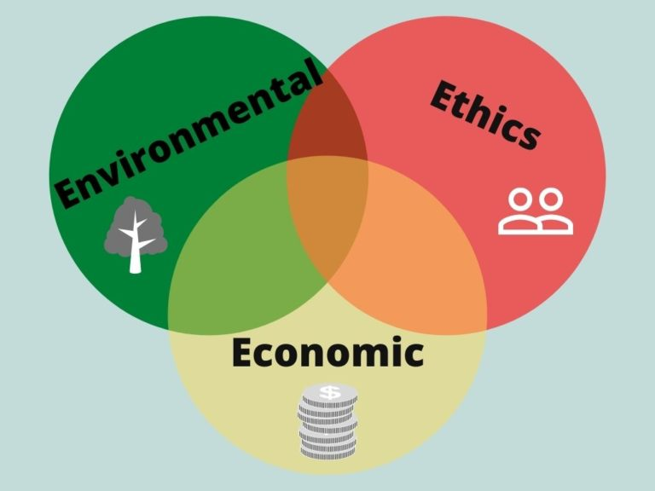
SUSTAINABILITY AND DIVERSITY
Sustainability
“Development which meets the needs of current generations without compromising the ability of future generations to meet their own needs.”
Explained by 3Es
Balance between all these three aspects could lead to sustainable development.

Slide 13
Environment
To optimize the organization, stakeholders must be included and processes must support each individual.
Without inclusive practices that support individual requirements, the organization will lose a significant stakeholder base.
diverse, equitable, and inclusive workplace improves the environmental impact of a company
Company leaders must communicate with many diverse people internally and externally to reduce their environmental impact.
To succeed, they must manage different teams and have cultural intelligence.
Ways it can be achieved
1. Equity and inclusion help create equitable and inclusive processes
Employing people from local communities enhances understanding of the impact of activities on the environment, fostering trust and enabling stronger support measures.
2. Inclusive leaders possess higher cultural intelligence and skills to manage diversity
Environmental activities frequently demand dramatic steps like rethinking product design, supply chain, and organizational behavior toward sustainability.
Ethnic and gender diverse firms are 20% more innovative and 35% more likely to outperform homogenous teams.
3. Diversity helps build better strategies
4. Diverse teams are more innovative and better prepared to take bold actions

Slide 14
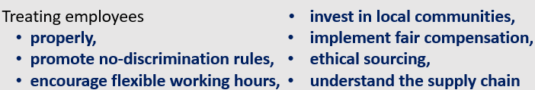
Ethics
diverse, equitable, and inclusive workplace improves the ethical impact
It lets everyone contribute to the company's sustainability.
Employees who feel appreciated and heard are more inclined to support business policies and cooperate toward a common objective.
Ways it can be achieved
1. Promoting equity in the firm offers equal chances and treatment for everybody.
Leaders that understand inclusive leadership and recognize their unconscious bias and privilege make more ethical decisions.
2. Inclusion leads to conscious decision making
Feeling comfortable is essential for human performance. Safe workplaces allow employees to be themselves, discuss vulnerabilities, and fail without fear. This boosts team performance, risk-taking, and employee happiness.
3. Inclusive workplaces have better psychological safety
A diverse workforce and minority stakeholders help the company identify untapped markets and discriminatory products, services, marketing campaigns, and practices, making it a responsible brand for customers and employees.
4. Diversity and inclusion promote company reach and prevent discrimination.

Slide 15
Economic
Economic aspect of sustainability is not just about being profitable, but also about having good governance within the company.
Management and other stakeholders like end-users, value chain, etc. are aligned on common interests.
The company is transparent and avoids conflict of interest.
diverse, equitable, and inclusive workplace improves the economic impact
Ways it can be achieved
Culturally diverse boards managed well worldwide earn 43% more than homogeneous boards. This demonstrates why diversity benefits the business.
1.Diversity with inclusion is profitable for the business
2. Inclusive organizations promote transparency
Inclusive organizations foster equitable opportunity and a safe atmosphere, ensuring honest communication and strong governance.
3. Empathetic teams handle conflicts and confrontations better.
To maintain a fair governance and strong leadership.
4. Diverse and inclusive teams promote a trustworthy brand image
The organization can better comprehend stakeholder, end-user, value-chain, customer, and other viewpoints with more diversity and representation. Maintaining trust and gaining support is easy.

Slide 16
Summary - 3 Es
Sustainability and Diversity, Equity and inclusion (DEI) are strictly intertwined.
Creating a workplace where employees can be themselves and perform at their best is the first step to executing a sustainability strategy.
Inclusive workplaces foster a safe atmosphere for employees to adapt to structural and behavioral changes, boosting sustainability efforts.

Slide 17
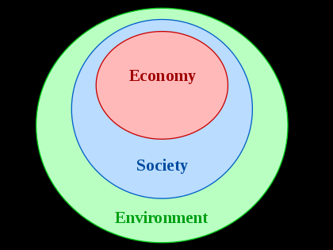
ENGINEER’S ROLE TO ACHIEVE SUSTAINABLE DEVELOPMENT
Engineers should carry out their role in abroad context that encompasses social, ethical, environmental, and economic challenges.
There are principles that will guide an engineer to achieve sustainable development.
They will help engineers meet their professional obligations to seek to achieve sustainability and ensure that this goal is integrated into all their engineering activities.
Contribute to building a sustainable society, present and future Engineers have a responsibility to maximize the value of their activity towards building a sustainable world.
This requires an understanding of what society demands and what is achievable, and are cognition that these change overtime.

Slide 18
Professional engineers should have the following principles:
Recognize that though their activity may be local and immediate, the potential impacts of their work may be global and long-lasting
have an understanding of other relevant social and cultural structures outside their own normal community of practice
understand their important role in the sustainable development of communities
recognize the impacts of an engineering project on communities, global or local, and incorporate the views and concerns of the communities
look at the broad picture
ensure that their knowledge about sustainable development is up-to-date
be prepared to influence the decision-maker for a project
Identify all the issues and options to the decision-maker about projects of that decisions are soundly based
Identify options that take account of economic, social, and environmental outcomes
Ensure that offered solutions and options will contribute to sustainability

Slide 19
Professional engineers should have the following principles: (cont.)
Be aware that there are inherently conflicting and un-measurable aspects of sustainability Do more than just comply with legislation and codes In seeking sustainable solutions, complying with current legislation, codes and environmental protection regulations may not be sufficient.
Go beyond the minimum wherever possible, anticipating future legislation that may be stronger
By their example, help others improve their performance
Alert the relevant authorities if there are deficiencies in legislation and if sustainable solutions and outcomes could been dangered by regulatory change
Use their technical expertise to drive new legislation and codes Use resources efficiently and effectively Engineers have as towards hip role with respect to planetary resources, and a responsibility to society to create more useful products and services with the lowest possible consumption of raw materials, water and energy.
Understand that there are environmental limits and finite resources
Reduce resource demand by using less in the first place
Reduce waste production by being efficient with resources that are used

Slide 20
Professional engineers should have the following principles: (cont.)
Use systems and products that reduce embedded carbon, energy and water use, waste and pollution
Adopt strategies for re-use, recycling, decommissioning and disposal of components and materials
Minimize any adverse impacts on sustainability at the design stage
Work to repair any damage
Engage with stakeholders, listening and recognizing the value of the perspectives of others, including non-specialists
Avoid working in isolation, involving other professionals at all stages of a project
Utilize cross-disciplinary knowledge and diverse skills
Promote the important leadership role of the engineer in finding solutions to sustainability challenges for the benefit of society
Seek a balanced approach

Slide 21
Manage risk to minimize adverse impact to people or the environment
Engineers are routinely involved in planning and managing projects where they should:
Harness their skills to minimize damage to people or the environment from engineering processes and products.
Undertake a comprehensive risk assessment before a project begins.
Ensure that the risk assessment includes the potential environmental, economic, and social impacts, beyond the lifetime of the engineering project.

Slide 22
PROFESSIONAL ORGANIZATIONS FOR ENGINEERS
Engineering professional organizations provide important support to engineers.
These groups work to advocate on behalf of engineers, provide professional development opportunities, publish updates on the latest innovations, and connect engineers to the community.
Anyone pursuing a Master of Engineering Management degree would benefit from becoming a member of at least one of these organizations.
Following are the top 5 engineering associations, which serve both the general profession of engineering as well as specific industries within the field.
National Society of Professional Engineers
IEEE
American Association of Engineering Societies
Society of Women Engineers
International Engineering Consortium

Slide 23
Top organizations that are highly rated by current professionals in the field are briefed:
National Society of Professional Engineers
The National Society of Professional Engineers was established in 1934 and is one of the only professional organizations for engineers that has stated goal of addressing the non-technical concerns of professional and licensed engineers.
It is a multidisciplinary national organization that encourages its members to discuss and critique its ability to create change for them within the field as well as providing continuing education and networking opportunities to support better career mobility.
It is currently one of the only nontechnical organizations in the country to support engineers.

Slide 24
IEEE
The IEEE is noted for being the world's largest technical professional organization that prides itself on the advancement of technology in all fields of engineering.
With over 420,000 members spanning 160 countries, it is an international organization that is active in corporate identity, governance, global public policy, and education.
The IEEE's publications and conferences often lead to employment for its members, and professional engineers often join the society as one of their first memberships after college, reinforcing the idea that a global network of engineers is needed to advance engineering.

Slide 25
American Association of Engineering Societies
The American Association of Engineering Societies was established in 1979 is one of the five best professional organizations for engineers; it is a multidisciplinary organization that is dedicated to the knowledge and practice of the field.
It is also known for providing access to all professionals in the field, including educators, government workers, and researchers.
It is a nonprofit organization that aims to be a collective voice for the engineering community within the United States.
The group also has a stated goal of working with international engineering societies, enabling the free flow of information and technology between countries, making it an exciting network for any professional.

Slide 26
Society of Women Engineers
The Society of Women Engineers focuses on women within the field; it is an association that delivers continuing education as well as networking opportunities to its members.
It is one of best professional organizations for engineers because it provides leadership workshops, educational programs, and more in an inclusive manner for women who are interested in becoming the best in the field.
Membership to the society includes resources, debate forums, awards and recognition programs, publication opportunities and more, enabling women engineers to do everything from further their career to opening up discussions about diversity in STEM.

Slide 27
International Engineering Consortium
The International Engineering Consortium was established in 1944 and is the leading nonprofit organization that brings together both universities and engineering societies for the purpose of the continuing education of engineers.
By offering engineers the chance to take on post-professional education through its programs, the consortium is ensuring that the field continues to evolve as the understanding of engineering changes with new advancements and technologies.
The IEC is also the head of the Electrical and Computer Engineering Department Heads Association, which is dedicated to sharing information among American Universities about the industry and any changes it encounters, passing that information down to students at the undergraduate and graduate levels.

Slide 28
Thank you

